Slide 1
Advanced Systems Analysis and Design Requirements Elicitation SOFT 30121 L5

Slide 2

Requirements Elicitation
RecoSystems Analysis and Design
Alan Dennis; Barbara Haley Wixom; Roberta M. Roth
2019
Chapter 3

Slide 3
Requirements Elicitation
Objectives of Lecture 5
Explain the analysis phase of the SDLC.
Describe the content and purpose of the requirements definition statement.
Classify requirements correctly as business, user, functional, or non-functional requirements.
Employ the requirement elicitation techniques of interviews, JAD sessions, questionnaires, document analysis, and observation.
Define the role that each requirement elicitation technique plays in determining requirements.
Describe several analysis strategies that can help the analyst discover requirements.
SOURCE: RecoSystems Analysis and Design
Alan Dennis; Barbara Haley Wixom; Roberta M. Roth
2019
Chapter 3

Slide 4
The Analysis phase
The planning phase deliverables (the system request, feasibility study and project plan) are key inputs into the analysis phase
The process of analysis involves three steps:
Understanding the existing situation
Identifying requirements
Defining the requirements for the new system
The outputs of the Analysis phase include the requirements definition, use cases, process model and data model
The line between analysis and design phases is blurry, some aspects of initial design will likely be included in the analysis phase.

Slide 5
Requirements Determination
Critical thinking skills are important here! The clients requests do not always translate easily into useful requirements
Determining requirements is arguably the most critical aspect of the SDLC. Failing the determine the correct requirements is the primary cause of systems development projects.
The later the requirements are changed, the more rework will be involved. This is where iterative development processes can be beneficial.

Slide 6
What is a requirement?
A requirement is a statement of what the system must do or what characteristics it needs to have.
Requirements provide different perspectives:
Business Requirements: What the business needs
User Requirements: What the users need to do
Functional Requirements: What the software should do
Non-functional Requirements: What characteristics the system should have
System Requirements: How the system should be built

Slide 7
Business Requirements
Statements in the systems request that describe the reasons for proposing the systems development project reflect the business requirements
When the systems development is complete, success will be measured by evaluating whether these business requirements have actually been met, they provide overall direction for the project
Example: “Provide account access to mobile customers”

Slide 8
User Requirements
Describe tasks that the users perform as an integral part of the business’ operation
Use cases are tools used to clarify the steps in performing these user tasks
Example: “Place a new customer order”

Slide 9
Functional Requirements
Relates directly to a process the system should perform as a part of supporting a user task, or information it should provide as the user is performing the task.
IIBA defines them as “the product capabilities or things that a product must do for its users”
Example (Process): “The system must allow registered customers to review their own order history for the past 3 years.”
Example (Information): “The system must retain customer order history for 3 years”

Slide 10
Non-functional Requirements
IIBA definition: “The quality attributes, design and implementation constraints and external interfaces which a product must have.”
These are used heavily when making design decisions about the user interface
Example: “The ability to access the system through a mobile device”

Slide 11
The process of determining requirements
Both business and IT perspectives are needed to determine requirements during the analysis phase.
Systems analysts may not understand the true business needs of the users, while the business users may not be aware of promising new technologies
Elicitation techniques include interviews, questionnaires, observation, joint application development (JAD) and document analysis
The analyst works with all stakeholders to prioritise the importance of the requirements identified.
Keeping the requirements list focused is key to project success

Slide 12
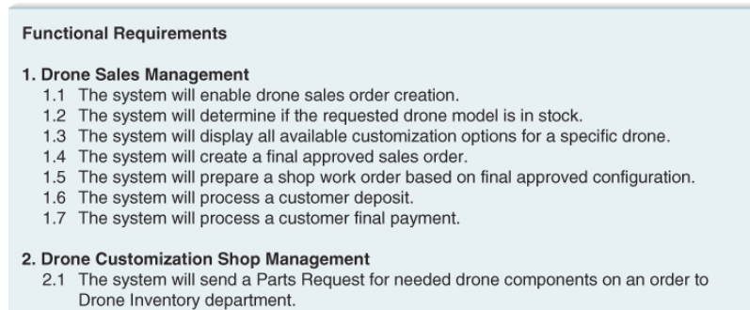
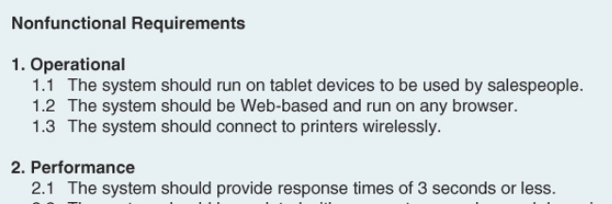
The requirements definition statement
Lists the functional and non-functional requirements.
Requirements can be prioritised using MoSCoW (Must haves, should haves, Could haves, and sometimes Won’t haves)

Slide 13
Requirements elicitation in practice:
A good analyst must make sure the that the current business processes and needs of the new system are well understood before moving on to design
All of the key stakeholders must be included in requirements elicitation
Respect the time commitment you are asking those involved to make! Prepare questions in advance etc.

Slide 14
Interviews:
It is important to include both managers who oversee the processes and the staff who actually perform the processes to gain both a high-level and low-level perspectives
Closed-ended questions enable analysts to obtain the specific information they need, but may not tell the whole story
Open-ended questions seek a more wide-ranging response from the interviewee.
Probing questions follow up on what has just been discussed in order to learn more.
Avoid asking about information that is available from another source. It’s often easier to read information off a form/report than to have someone describe it to you.

Slide 15
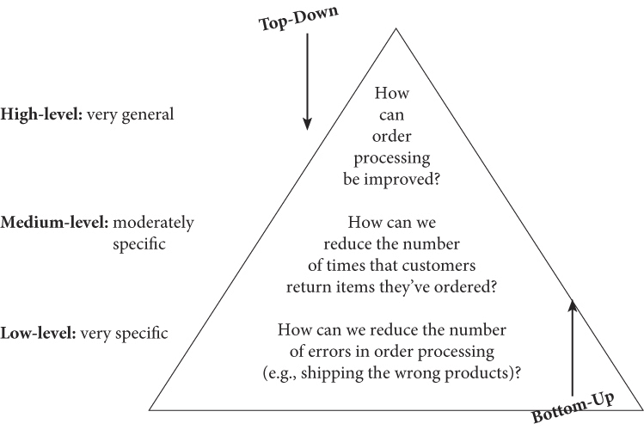
Interviews cont.:
As the project progresses, and the analyst understands the process much better, structured interviews in which specific, often closed ended sets of questions are developed prior to the interview.
Two approaches exist for organising the interview questions: top down and bottom up.
Top down is best for most interviews, as it allows the analyst to understand the topic before needing to understand specifics
Bottom up can be better when talking to lower-level staff members

Slide 16
Conducting interviews
Some tips for conducting interviews:
Make sure you record all the information the interviewee provides! This could be through taking notes or audio recording the interview. (Make sure the interviewee is comfortable with this first though!)
If you don’t understand something, make sure you ask! The whole point of you interviewing them is to understand the system better.
Separate facts from opinion, though don’t ignore information just because it’s the interviewee’s opinion, it can be just as useful

Slide 17
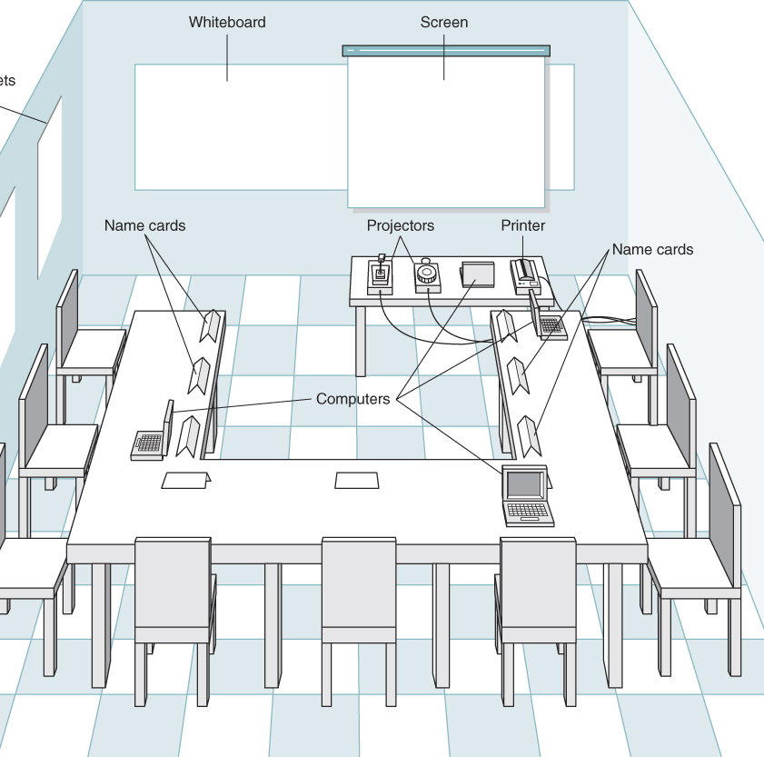
Joint application development:
Is an information gathering technique that allows the project team, users and management to work together to identify requirements for the system. Developed by IBM in the late 1970s
Directed by a facilitator skilled in JAD techniques who remains neutral in the discussion
Often takes place in a specially prepared JAD meeting room, arranged so all participants can see each other.

Slide 18

Questionnaires
Often used when there is a large number of people from whom information and opinions are needed
Typically a subset of people are selected representative of the entire group
The response rates for questionnaires can be very low, so it can be useful to:
Begin with questions important to respondents
Review the questionnaire first (Questions can be misunderstood)
Make sure you know how the questionnaire data will be analysed the questionnaire is distributed.

Slide 19
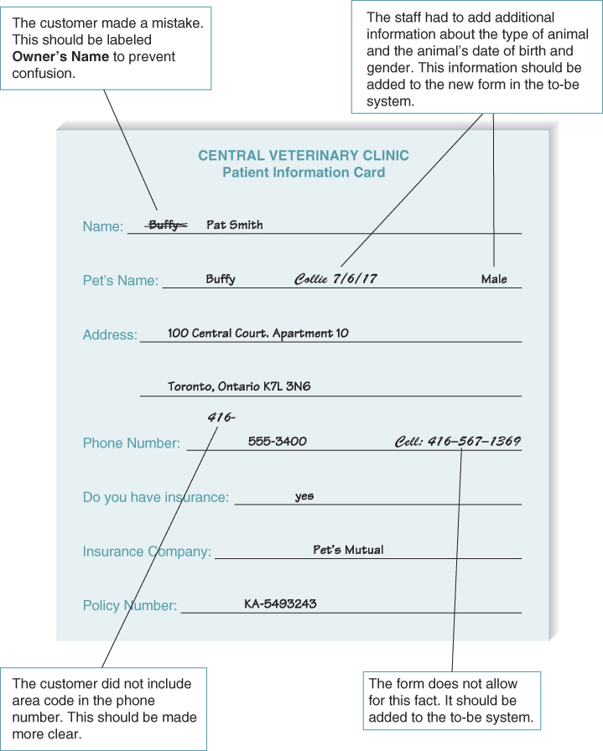
Document Analysis
Useful when the existing system is well documented
Often the “real” system differs from the documented one however…

Slide 20

Observation
The act of watching processes being performed.
Can be more effective that doc. Analysis as you see the “real” system in use.
Is useful for checking the validity of information gathered from other sources.

Slide 21
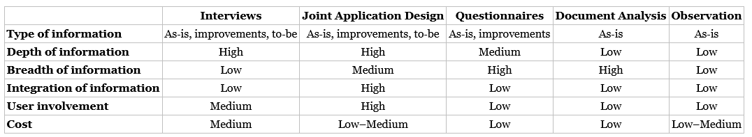
Selecting the Appropriate techniques
Each technique has it’s strengths and weaknesses
Most projects benefit from a combination of techniques

Slide 22
Requirements analysis strategies
As analysts, you must encourage your stakeholders to think critically about the needs for the new system.
Requirements analysis strategies can be used to accomplish this goal
Problem analysis, Root cause analysis, duration analysis, and Activity based costing are just a handful of examples
Again, each of these have their own purpose. No one technique is inherently better than the others.

Slide 23
Problem Analysis
Means asking the users and managers to identify problems with the as-is system, and how to solve them
Users often have a good idea of the changes they would like to see, and have ideas for solutions
However, since these focus on problems with the existing solution, they concentrate less on new opportunities
This can mean it only provides minor improvements in business value
Problem analysis

Slide 24
Root Cause Analysis
Focuses on the problem first, rather than solutions
Avoids the situation where a symptom is addressed rather than the problem itself

Slide 25
Duration Analysis
-It’s an examination of the amount of time it takes to perform each process in the existing system
Compares this time to the actual total time for the overall process. If there’s a large different this often indicates bad fragmentation
This might mean the overall process is a good candidate for process integration or parallelization

Slide 26
Activity Based Costing
Similar to duration analysis. Examines the cost of each major process (rather than time taken)
The costliest processes are then focused on
Assigning costs can be done through adding the costs of labor and materials (though it is often more complex than this)

Slide 27
Next Lecture
Use Case Analysis

